Slide 1
Market Trends and Investor Bwehaviour (Final presentation)
By:
DIVYA MATAVALAM,
VENKATA BHASKARA REDDY TETALI,
LELIHAS KONETI
AJAY KUMAR AKULA

Slide 2
Main Goal of this Project :
The overarching goal of this project is to provide investors, both individual and institutional, with valuable insights that foster informed decision-making and optimize returns in the face of constant fluctuations. By delving into historical financial data, employing advanced data analysis techniques, and leveraging cutting-edge machine learning methodologies, the project aims to unravel the complex relationships underlying market dynamics. The ultimate aspiration is to empower stakeholders with the knowledge and tools necessary to navigate the complexities of the financial markets with confidence, poise, and a heightened ability to achieve their financial goals.
The project's significance is rooted in its Endeavor to unravel the multifaceted connections between market trends and investor behaviour. Through the strategic utilization of data analysis and cutting-edge machine learning techniques, the project seeks to offer valuable insights to a broad spectrum of investors, ranging from individual to institutional.
Ensure the project's practical applicability by interpreting results in the context of real-world market events.

Slide 3
Data Collection and Pre-processing :
Making Sure the data is accurate and complete by handling missing values and the outliers.
Here the data cleaning is performed in each machine learning model separately ( i.e., 5 models performed in this project )
Handling missing values, dealing with the duplicates, Outlier detection, correcting inconsistent data, encoding categorical variables, feature scaling, data splitting, time series handling, Text data preprocessing.

Slide 4
The models performed in this project Analysis:
1. Supervised Learning Model.
2. K Means Clustering.
3. Decision Trees.
4. Neural Networks model.
5. Maximum Likelihood Model.

Slide 5
Supervised Learning Model :
Here we considered the variable “AUM” as target variable.
Mean Squared Error: 2846936691156.8086 ( approximately 2.85 trillion ).
Here MSE which we got is quite large depends on AUM variable,a higher MSE suggests that the model's predictions deviate significantly from the true values, highlighting potential limitations in the chosen features or the model's complexity. It's crucial to interpret the MSE in the context of the specific problem;
However the absolute value of MSE doesn’t provide an intuitive sense of the model’s performance unless it is compared to the baseline model.

Slide 6
From the residual plot of machine learning model:
- The predicted values are more than the actual values, resulting a negative residual.
Further refinement may involve feature engineering, exploring different algorithms, or considering non-linear relationships to enhance the model's performance and reduce prediction errors.

Slide 7
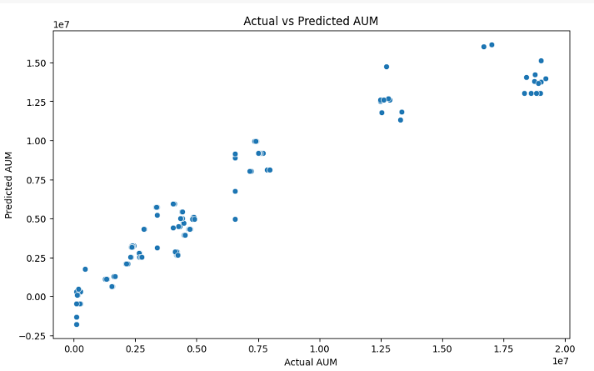
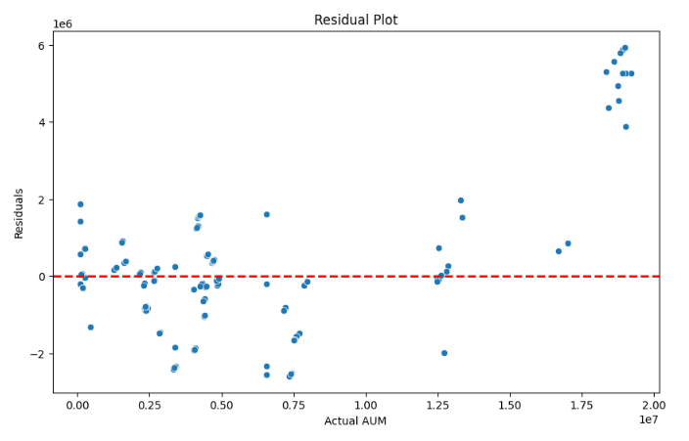
Interpretations for Supervised Learning:

Slide 8

K-MEANS CLUSTERING
It is a popular unsupervised machine learning algorithm used for partitioning a dataset into K distinct, non-overlapping clusters.
Dataset contains various investor features: 'Longevity,' 'Female,' 'Age,' 'Income,' and more.
Applied K-means clustering with three clusters to analyze investor behavior.
Cluster 0: Moderate values across features, average 'Longevity' around 7 years, balanced gender distribution, moderate 'Income,' and 'AUM.'
Cluster 1: Longer 'Longevity,' higher 'Income' and 'AUM,' slightly older investors with a more diversified portfolio.
Cluster 2: Notably high values in 'Longevity,' 'AUM,' and 'Trustworthiness,' indicating substantial market experience, assets, and trust.
Clustering reveals distinct investor segments with varying characteristics and financial profiles.

Slide 9
Segmentation Impact:
Identifies three distinct clusters, aiding understanding of diverse investor behaviors.
Provides insights into varying financial profiles and behavioral traits within each segment.
Enables targeted strategies tailored to the characteristics of each investor group.
Potential Business Applications:
Facilitates tailored marketing strategies for each cluster based on their specific traits.
Offers opportunities to design investment products/services for varied investor segments.
Identifies high-value segments and potential growth areas for strategic targeting.
Overall Significance:
Demonstrates the power of clustering in segmenting investor behavior without predefined categories.
Provides valuable insights aiding decision-making in finance, marketing, and product development.
Showcases the potential of data-driven approaches in understanding and engaging diverse investor profiles.

Slide 10
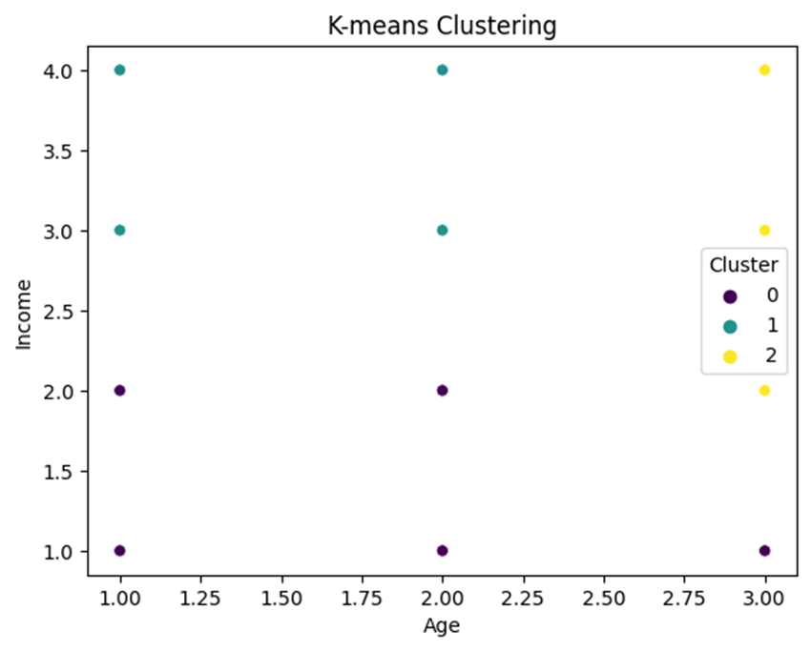
Cluster Centers:
Longevity Female Age Income ProfManage Diversification
0 7.051282 0.435897 1.692308 1.589744 2.435897 2.307692
1 10.203966 0.453258 1.611898 3.263456 3.056657 4.288952
2 22.132296 0.350195 3.000000 2.988327 6.132296 5.579767
Affordability Liquidity Growth Trustworthiness Technology Integrity
0 5.256410 4.871795 4.461538 2.794872 5.025641 2.692308
1 1.603399 2.643059 5.407932 4.116147 3.937677 3.399433
2 1.571984 2.284047 6.140078 6.116732 2.054475 6.229572
BrandValue AUM
0 2.871795 1.203598e+06
1 3.526912 3.954465e+06
2 6.202335 9.143764e+06

Slide 11
Neural Network Model
A neural network is a computational model inspired by the way biological neural networks in the human brain work. It's a key component of machine learning and artificial intelligence
The output of the Neural Network training process reveals the model's performance across 50 epochs. The loss, representing the Mean Squared Error (MSE), is displayed for both the training and validation datasets. In the initial epochs, the training and validation losses are extremely high, reaching into the tens of trillions. This suggests that the model struggles to capture the underlying patterns in the data effectively.

Slide 12
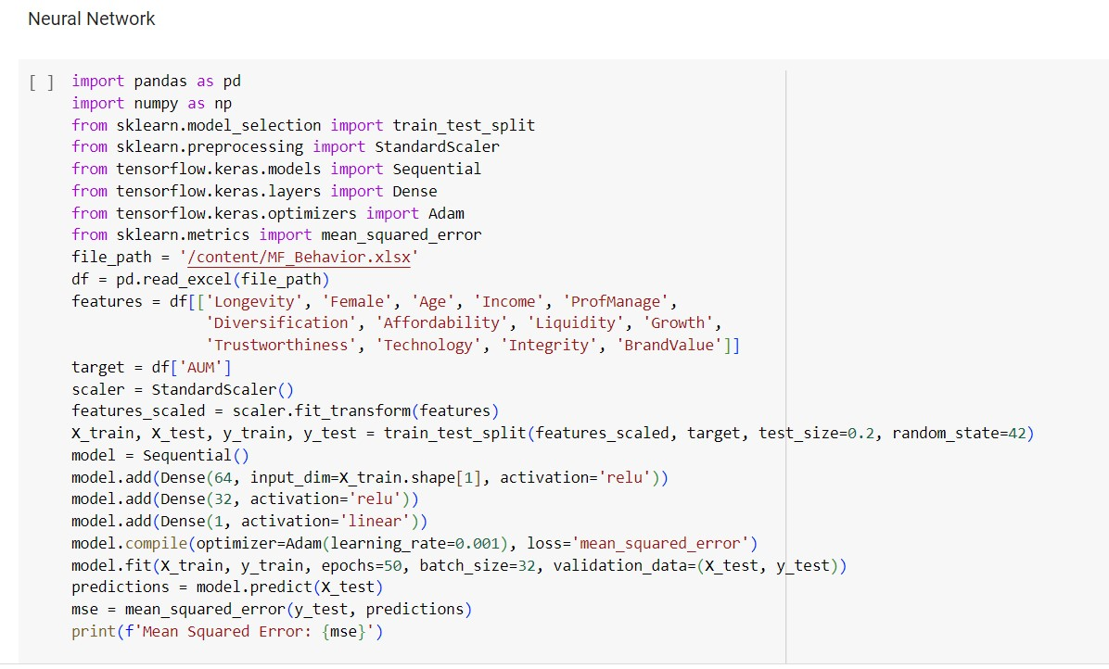
Code

Slide 13
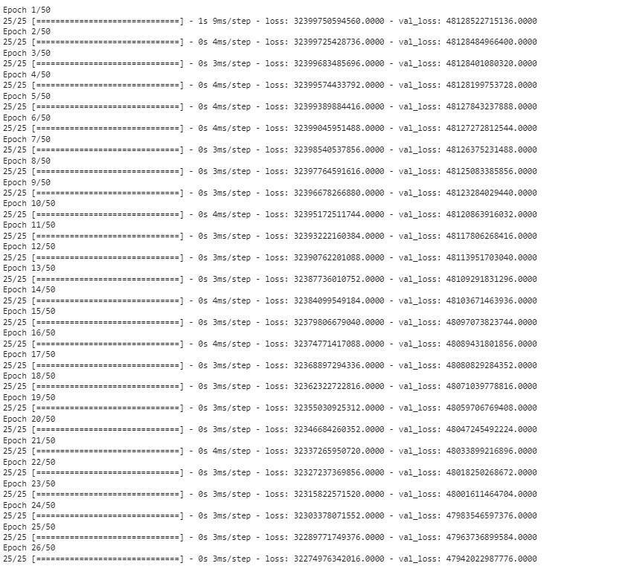
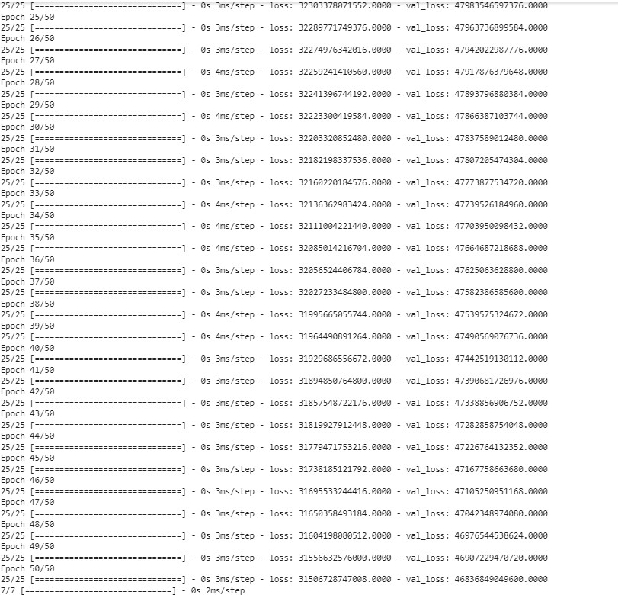
Output

Slide 14
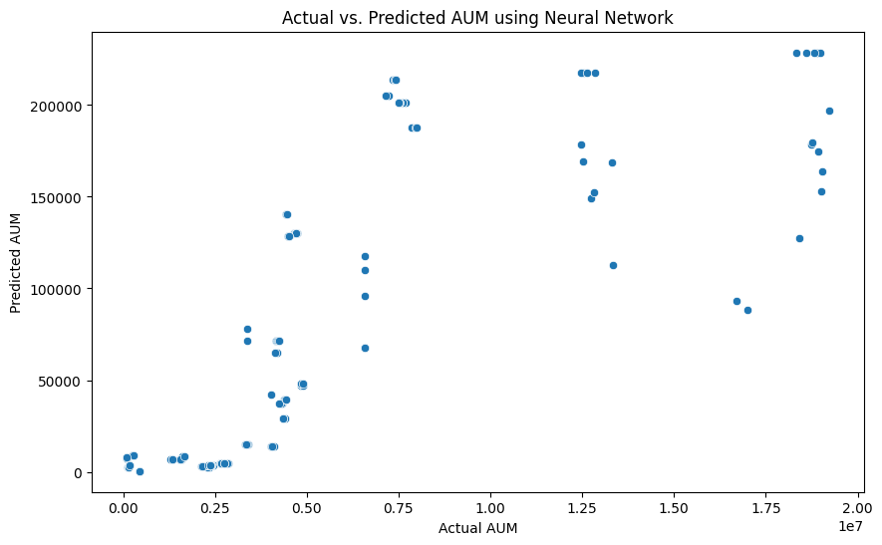
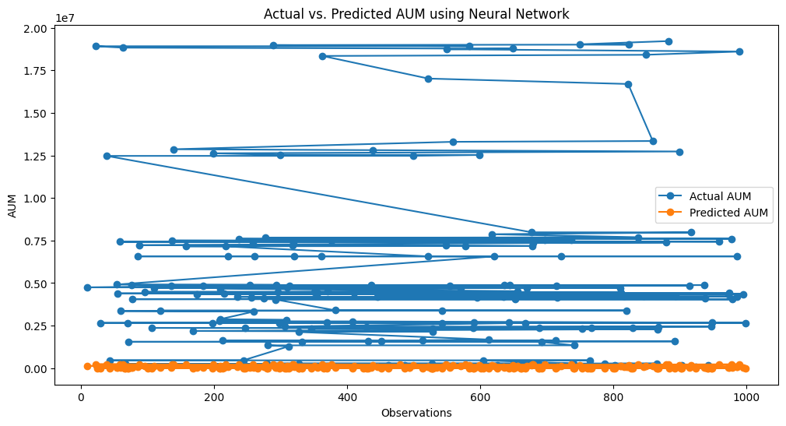

Slide 15
Decision Tree model
The Decision Tree model, characterized by its intricate branching structure, resulted in a Mean Squared Error (MSE) of approximately 11.42 billion. This suggests a complex and detailed capturing of the relationships within the dataset, potentially to the point of overfitting. In the context of the broader insights gained from the initial analysis, the Decision Tree's complexity aligns with the identification of key variables influencing market trends and the quantification of investor sentiment's impact on market dynamics. However, the relatively high MSE signals a need for refinement to enhance the model's accuracy. This parallels the broader exploration goals, where refining predictive models is identified as a key area for improvement.

Slide 16
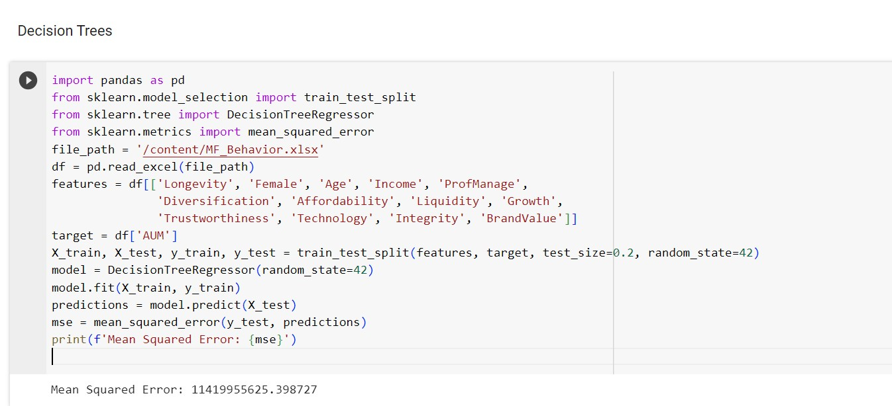
Code

Slide 17
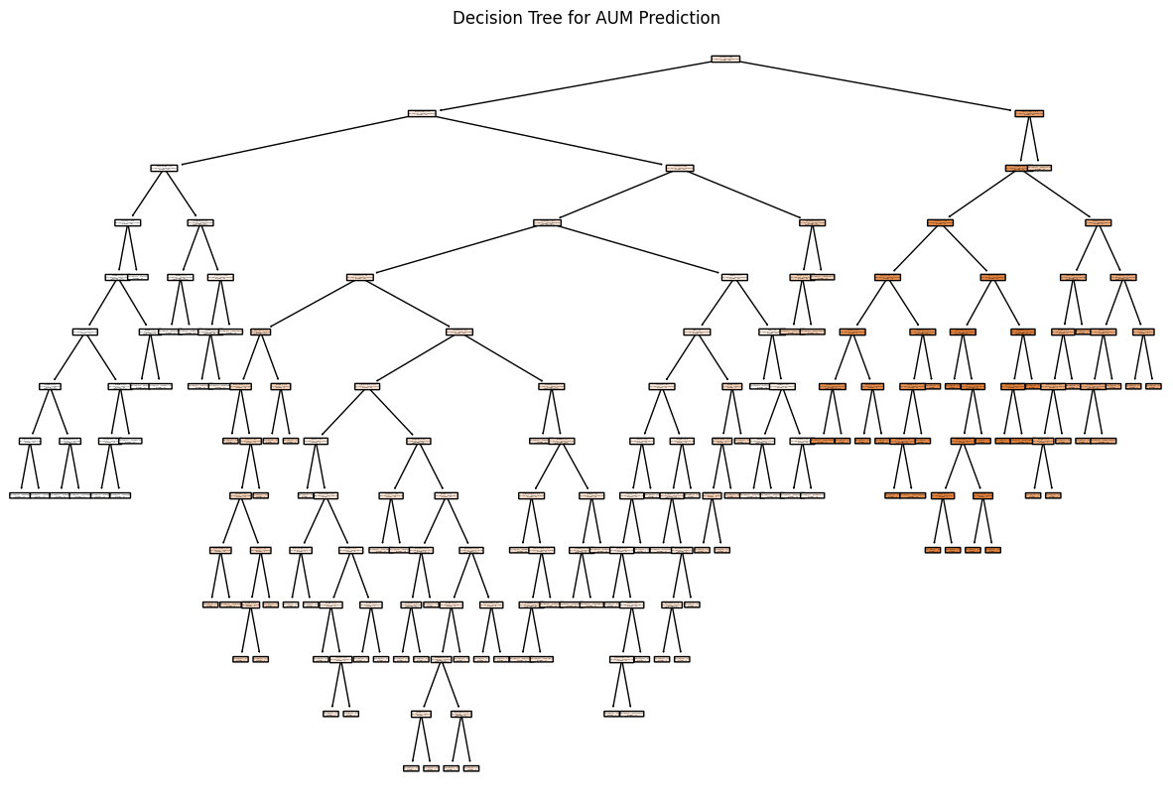
Decision Tree for AUM Prediction

Slide 18
Sentiment Analysis
Sentiment analysis, also known as opinion mining. It involves determining the emotional tone or subjective information expressed
An integral aspect of our research involves the nuanced task of decoding the emotional undercurrents within financial news
The goal is to unveil the emotional nuances embedded in news articles, providing valuable insights into how these sentiments influence investor behaviour and, reciprocally, how market trends impact sentiment.
sentiment analysis adds a layer of emotional intelligence to our research. By decoding the subtle emotional cues within financial news, they enhance our ability to comprehend the intricate relationship between sentiment and market dynamics, ultimately empowering investors with a deeper understanding of the forces shaping the financial landscape.

Slide 19
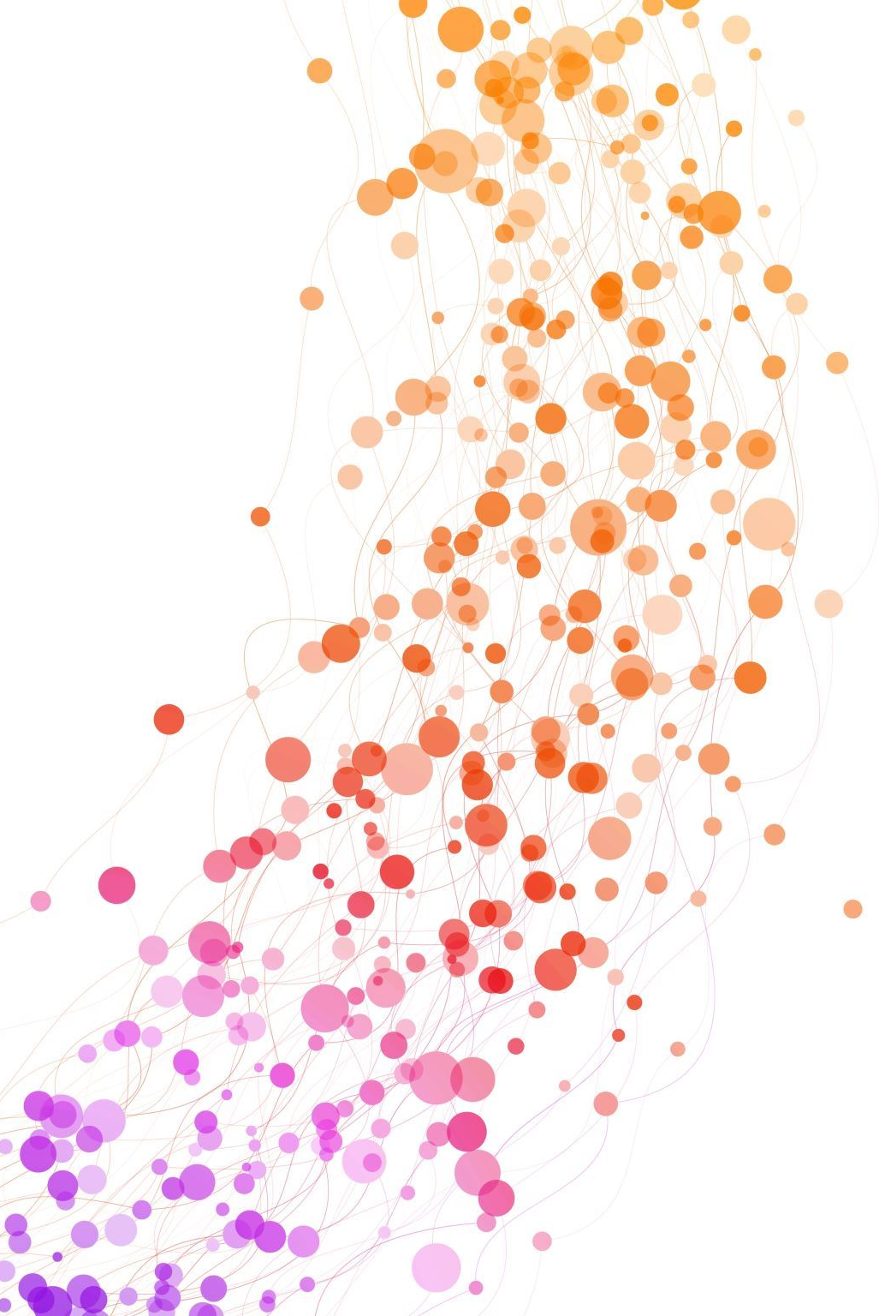

MAXIUMUM LIKELIHOOD
>Strategic focus on advanced data analysis and machine learning.
>Implementation phase breathes life into meticulously designed methods.
>Prominent use of sophisticated analytical and machine learning methodologies.
>Maximum Likelihood Estimation (MLE) models leveraged for precision.
>Ordinary Least Squares (OLS) regression yields robust results (R-squared: 0.988).
>F-statistic (6224) and low p-value affirm model significance.
>Coefficients show Age, Income, and Liquidity's strong associations with Longevity.
>Caution advised for potential multicollinearity, indicated by a large condition number.
>Diagnostic statistics (Durbin-Watson, Jarque-Bera) ensure model validity.
>Preliminary results unveil insights into market trends, investor behavior, validated by predictive models and impactful data visualizations.

Slide 20
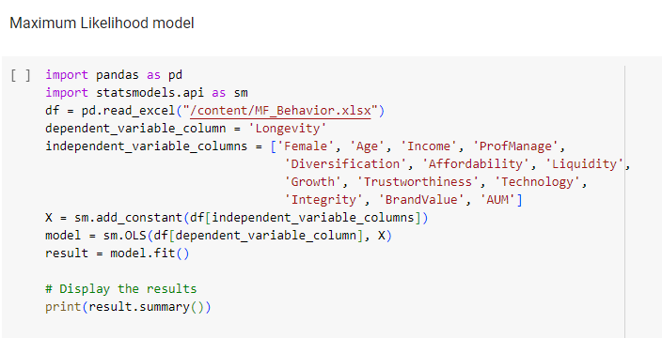
Code

Slide 21
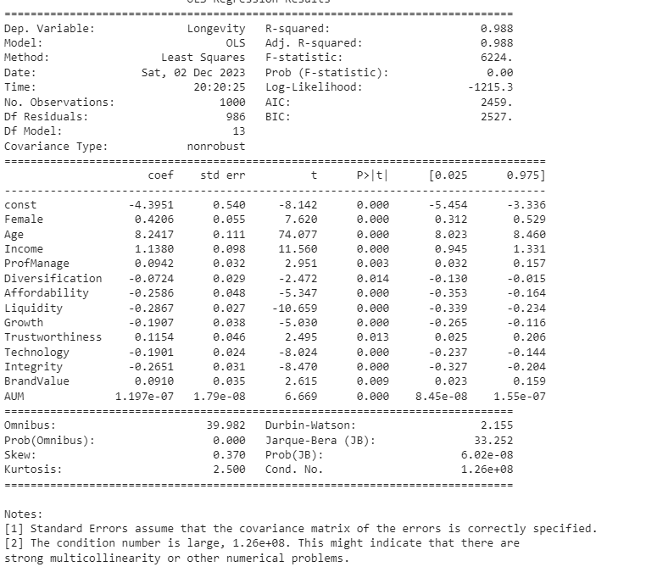
Output

Slide 22

Data Visualization and Interpretation
Making Data Understandable:
Transforming complex data into visuals for easy understanding.
Visual Design Leader:
Leading the creation of visual elements for a deeper grasp.
Responsibilities:
Creating impactful visuals, like charts and graphs.
Playing a crucial role in explaining results to stakeholders.
Balanced Contribution:
Spending 40% on designing informative and appealing visuals.
Allocating 60% to interpreting results for meaningful insights.
Adding Context and Insight:
Offering context to visuals for understanding patterns.
Uncovering the significance of relationships shown in visuals.
Team Collaboration:
Working with the team to enhance clarity and accessibility.
Providing stakeholders with knowledge and tools for navigating financial complexities.

Slide 23
CONCLUSION
Significant progress in understanding market trends and investor behavior.
Careful execution of foundational steps for a comprehensive exploration of finance.
Meticulous curation of the dataset for relevance and richness in line with research objectives.
Successful completion of the initial data pre-processing phase, ensuring dataset integrity.
In-depth exploration involving regression studies, correlation assessments, and sentiment analysis.
Collaborative efforts of the team, contributing to a profound understanding of market dynamics.
Implementation of statistical analyses, machine learning, and cutting-edge tools.
Selection of Maximum Likelihood Estimation (MLE) model with a remarkable R-squared (0.988) for predictive precision.

